Slide 1

Technology Trends Analysis Using Stack Overflow Developer Survey 2025
Chavi Jain
IBM Data Analyst Capstone Project
June 2026

Slide 2



OUTLINE
Executive Summary
Introduction
Methodology
Results
Visualization – Charts
Dashboard
Discussion
Findings & Implications
Conclusion
Appendix

Slide 3

EXECUTIVE SUMMARY
OBJECTIVE
Analyze developer survey data to identify current and future technology trends.
KEY FINDINGS
Python, JavaScript, and SQL are the most widely used programming languages.
PostgreSQL and MySQL remain the most popular databases.
Cloud platforms such as AWS and Azure dominate platform adoption.
Python, PostgreSQL, and cloud technologies show strong future demand.
Most respondents belong to the 25–44 age group.
RECOMMENDATION
Organizations should prioritize training in:
Python
Cloud Computing (AWS/Azure)
PostgreSQL
AI-related technologies

Slide 4

INTRODUCTION
BUSINESS PROBLEM
Technology evolves rapidly, making it difficult for organizations and professionals to identify valuable skills.
OBJECTIVES
Identify current technology trends
Analyze future technology preferences
Examine demographic characteristics
Provide recommendations for skill development
RESEARCH QUESTIONS
Which programming languages are most used?
Which databases are most desired?
What technologies are expected to grow?
What demographic patterns exist?

Slide 5

METHODOLOGY
DATA SOURCE
Stack Overflow Developer Survey Dataset
DATA COLLECTION
Job API Data
Web Scraping Data
Survey Dataset
DATA WRANGLING
Missing value treatment
Duplicate removal
Data transformation
Normalization
TOOLS USED
Python
Pandas
SQL
Matplotlib
SQLite
IBM Cognos Analytics

Slide 6
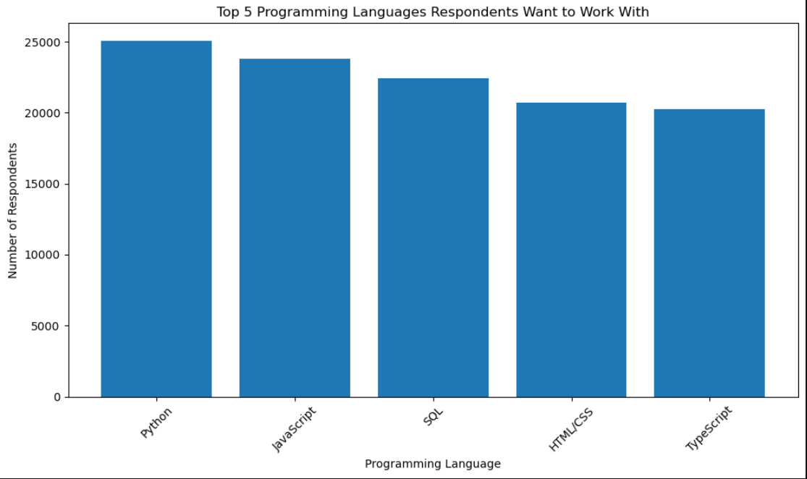
RESULTS
RESEARCH QUESTION 1: Which Programming Languages Are Most Used?
PROGRAMMING LANGUAGE TRENDS (CURRENT YEAR)
INTERPRETAION:
Key Findings
JavaScript, Python, SQL, Java, and TypeScript are among the most widely used languages.
Python continues to gain popularity due to Data Science, AI, and Automation.
JavaScript remains dominant because of web development demand.
Business Implication
Organizations should continue investing in Python and JavaScript skills because they remain highly relevant across industries.

Slide 7
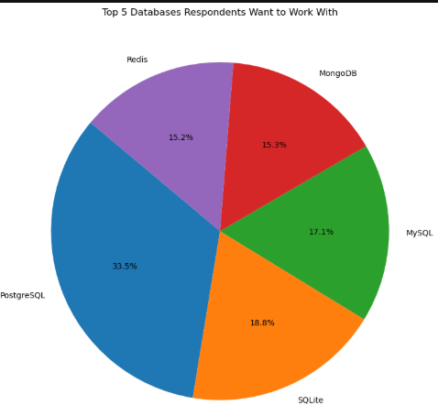
RESULTS
RESEARCH QUESTION 2: Which Databases Are Most Desired?
DATABASE TRENDS (FUTURE YEAR)
INTERPRETAION:
Key Findings
PostgreSQL appears as the most desired database.
MongoDB and Redis show increasing popularity.
Developers prefer modern databases that support scalability and cloud environments.
Business Implication
Companies should prioritize PostgreSQL and modern database technologies in training programs.

Slide 8
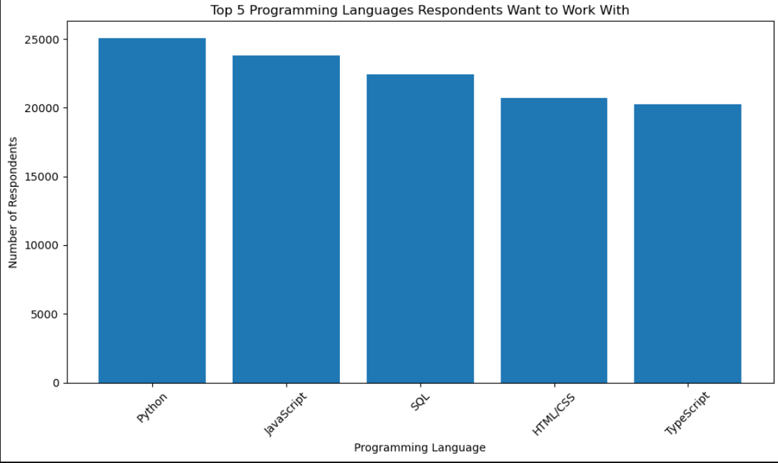
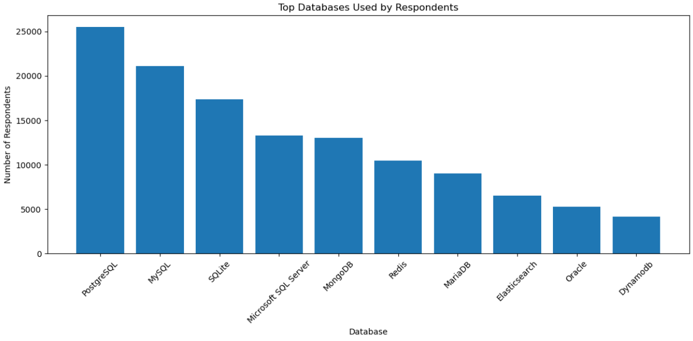
RESULTS
RESEARCH QUESTION 3: What Technologies Are Expected To Grow?
FUTURE TECHNOLOGY USED
INTERPRETAION:
Expected Growth Areas
Python
PostgreSQL
AWS
Azure
AI Tools
Cloud Technologies
Why?
Developers show strong interest in these technologies for future learning and career development.
Business Implication
Organizations should align workforce development with:
AI
Cloud Computing
Data Engineering
Python Ecosystem

Slide 9
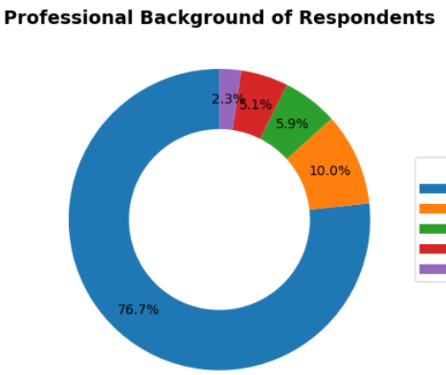
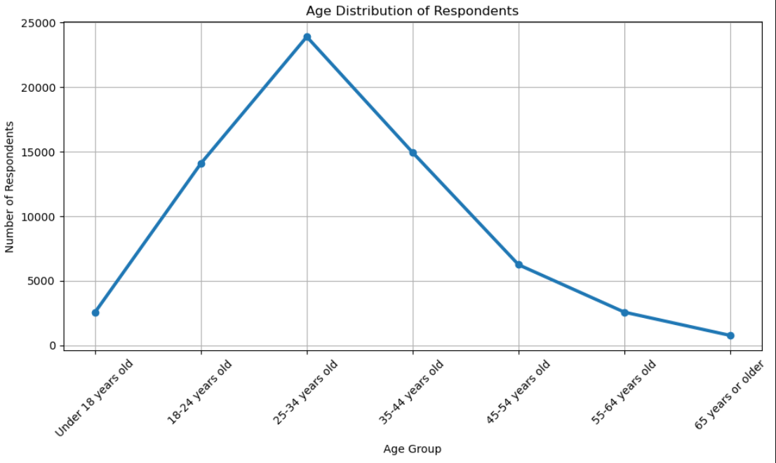
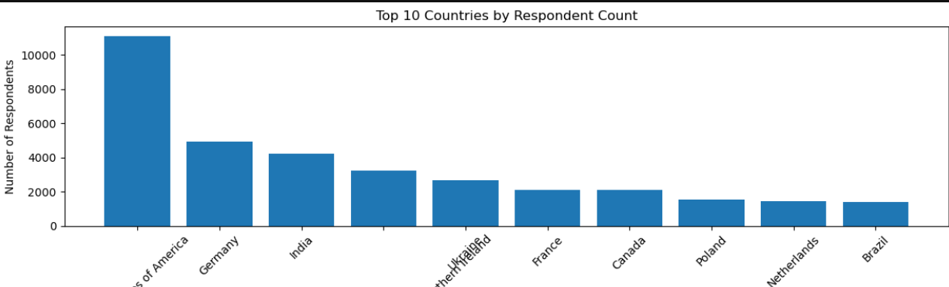
RESULTS
RESEARCH QUESTION 4: What Demographic Patterns Exist?
INTERPRETATION:
Age Distribution
Most respondents are between 25 and 44 years old.
The survey is dominated by early and mid-career professionals.
Geographic Distribution
United States
India
Germany
United Kingdom
represent the largest respondent groups.
Professional Background
Most respondents identify as:
Professional Developers
Full-time Employees
Business Implication
The survey insights primarily reflect the perspectives of active software professionals working in established technology markets.

Slide 10
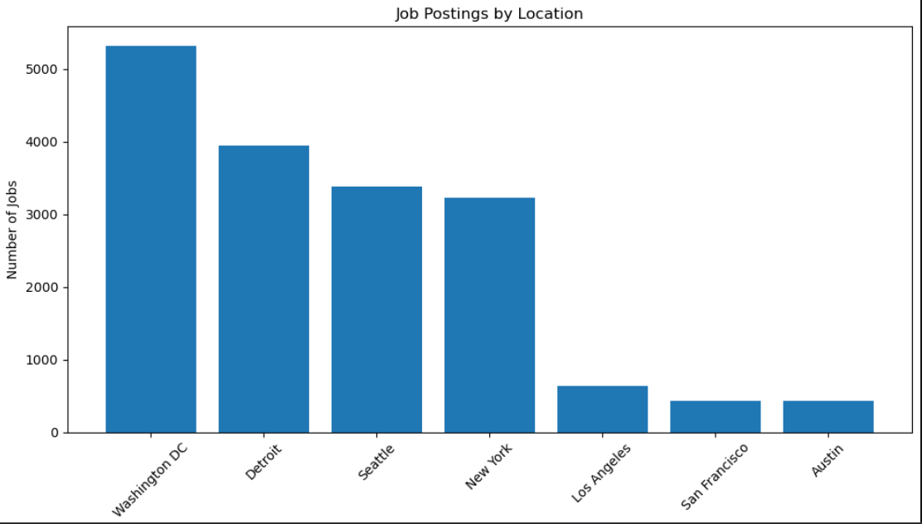
JOB POSTINGS
OBJECTIVE
Analyze the geographic distribution of job opportunities using data collected from the Job Posting API.
KEY FINDINGS
Washington DC recorded the highest number of job postings among the analyzed locations.
Seattle and New York also showed strong demand, indicating active technology and business job markets.
Los Angeles and San Francisco had comparatively fewer postings in this dataset.
Job opportunities are concentrated in major metropolitan and economic centers.
INTERPREATION
The analysis reveals that job demand is not evenly distributed across locations. Cities such as Washington DC, Seattle, and New York offer significantly more employment opportunities, making them attractive markets for technology professionals. This concentration suggests that organizations in these regions continue to invest heavily in technical talent.
BUSINESS IMPLICATION
Professionals seeking employment may find more opportunities in high-demand locations.
Organizations can use regional hiring trends to guide recruitment and workforce planning.
Geographic job demand can help identify emerging employment hubs and inform relocation or expansion decisions.

Slide 11
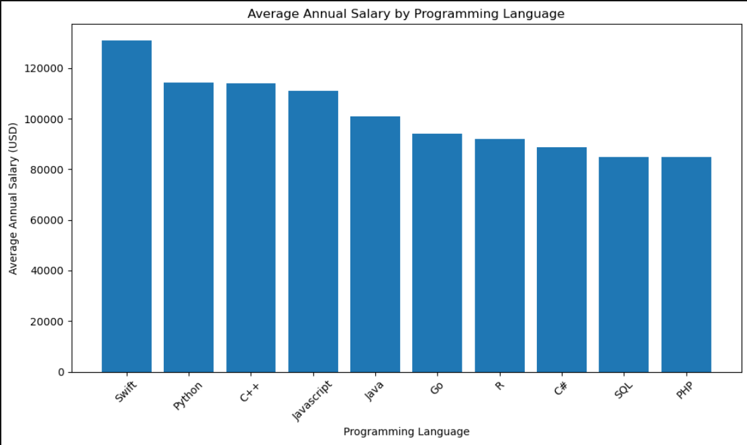
POPULAR LANGUAGES
KEY FINDINGS
Swift has the highest average annual salary among the analyzed languages.
Python and JavaScript also offer competitive salaries, reflecting their strong industry demand.
Java and R remain valuable skills with solid compensation levels.
Salary differences suggest varying market demand and specialization requirements across technologies.
INTERPRETATION
The analysis indicates that specialized and high-demand programming languages often command higher salaries. While Swift leads in compensation, Python and JavaScript combine strong salary potential with broad industry adoption, making them attractive career choices.
BUSINESS IMPLICATION
Professionals can use salary trends to guide skill development and career planning.
Organizations can benchmark compensation packages against market demand.
High-paying technologies may require targeted hiring and training strategies to attract qualified talent.

Slide 12
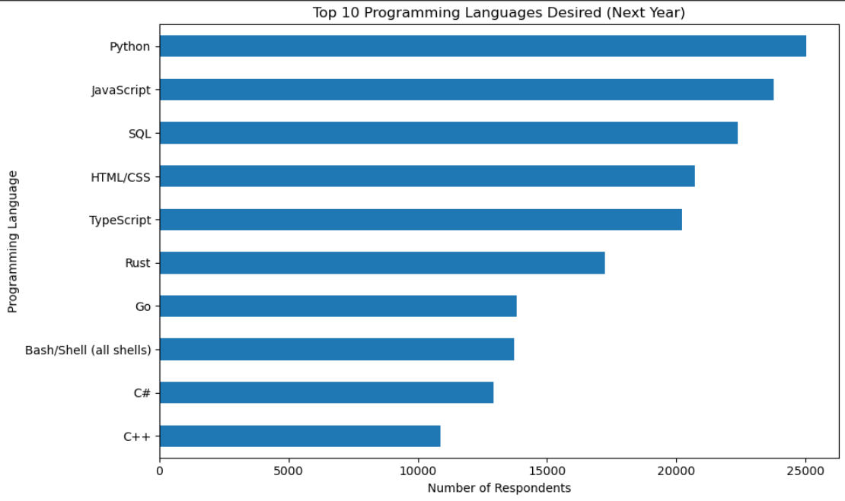
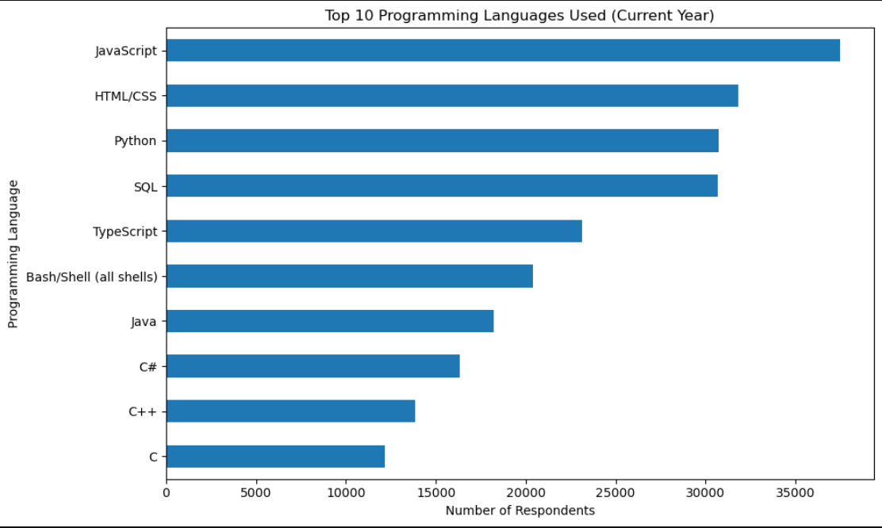
PROGRAMMING LANGUAGE TRENDS

Slide 13
PROGRAMMING LANGUAGE TRENDS - FINDINGS & IMPLICATIONS
FINDINGS
Python, JavaScript, and SQL are among the most widely used programming languages in the current developer ecosystem.
Python continues to show strong adoption due to its applications in Data Science, Artificial Intelligence, Machine Learning, and Automation.
JavaScript remains the dominant language for web development and continues to be a core technology for frontend and full-stack development.
Analysis of future preferences indicates increasing interest in Python, TypeScript, and Rust, suggesting continued growth in modern software development technologies.
The comparison between current usage and future interest highlights a shift toward technologies that support cloud computing, AI, and scalable applications.
IMPLICATIONS
Organizations should prioritize Python training and recruitment to meet growing demand in AI, Data Science, and automation-related projects.
Continued investment in JavaScript and TypeScript skills is essential to support modern web application development.
Emerging technologies such as Rust should be monitored as potential future strategic skills due to their increasing popularity among developers.
Educational institutions and training providers should align learning programs with evolving industry preferences to improve workforce readiness.
Businesses that proactively invest in high-demand programming skills are likely to gain a competitive advantage in technology adoption and talent acquisition.

Slide 14
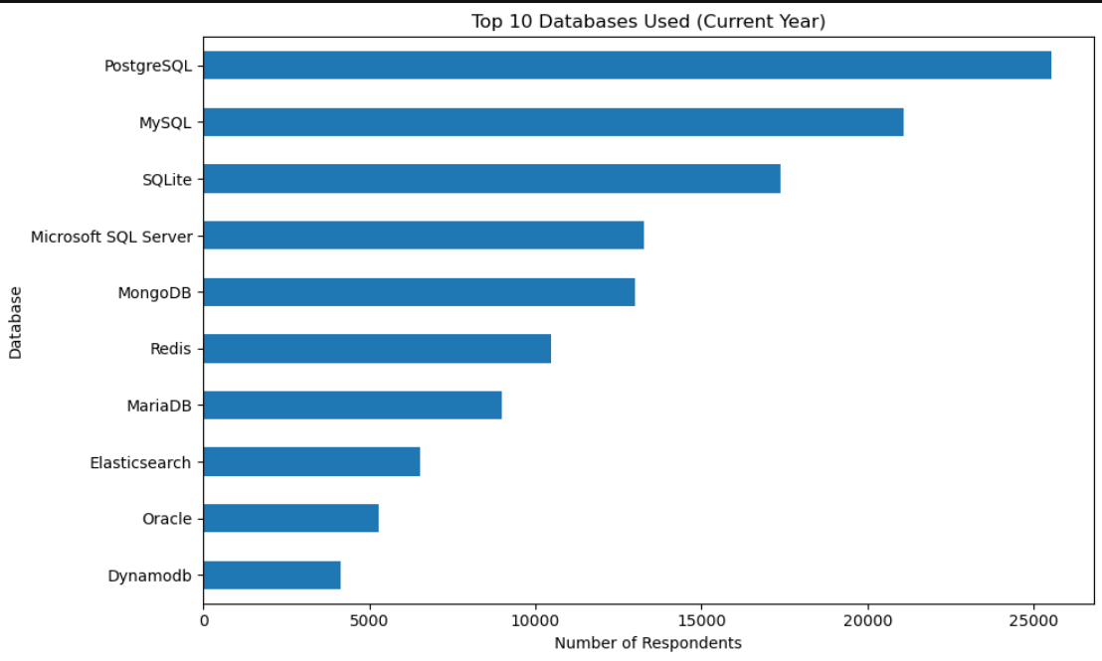
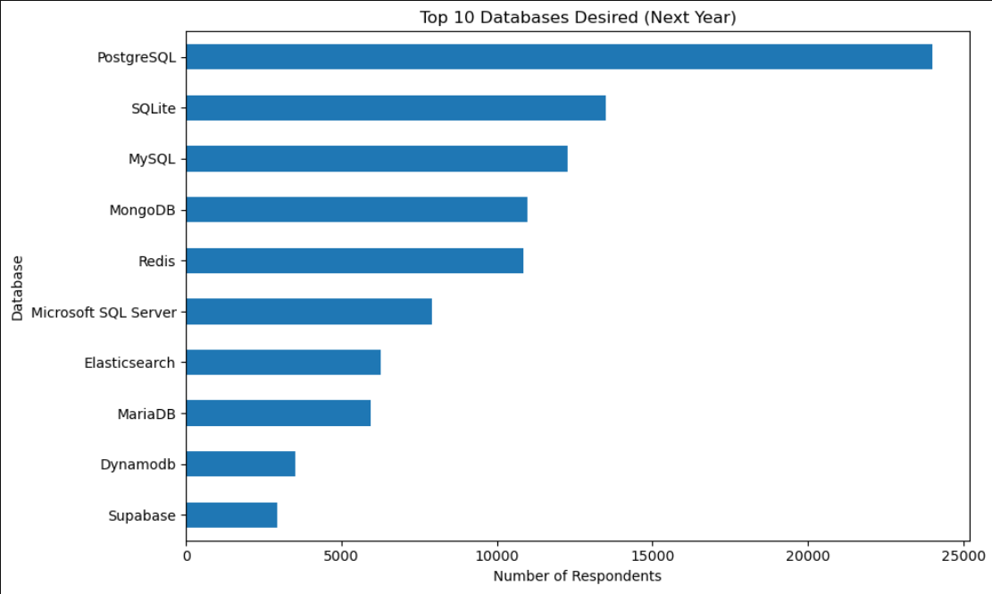
DATABASE TRENDS

Slide 15
DATABASE TRENDS - FINDINGS & IMPLICATIONS
FINDINGS
PostgreSQL is the leading database in both current usage and future preference.
MySQL remains widely adopted across the developer community.
MongoDB and Redis show increasing interest among developers.
Future preferences indicate a shift toward scalable and cloud-compatible database technologies.
IMPLICATIONS
Organizations should invest in PostgreSQL expertise to support future technology needs.
Developers should build skills in both relational (SQL) and NoSQL databases.
Growing interest in modern databases highlights the importance of cloud and data-driven a

Slide 16

DASHBOARD
Technology Trends & Demographics Dashboard Analysis
Purpose
The dashboards were developed using survey data to analyze:
Current Technology Usage
Future Technology Trends
Developer Demographics
Objective
Provide an interactive view of technology adoption patterns, future technology preferences, and respondent demographics to support data-driven decision making.
Dashboard Components
Dashboard Tab 1
Current Technology Usage
Programming Languages
Databases
Platforms
Web Frameworks
Dashboard Tab 2
Future Technology Trends
Languages Desired
Databases Desired
Platforms Desired
Web Frameworks Desired
Dashboard Tab 3
Demographics
Countries
Age Groups
Education Level
Professional Background

Slide 17
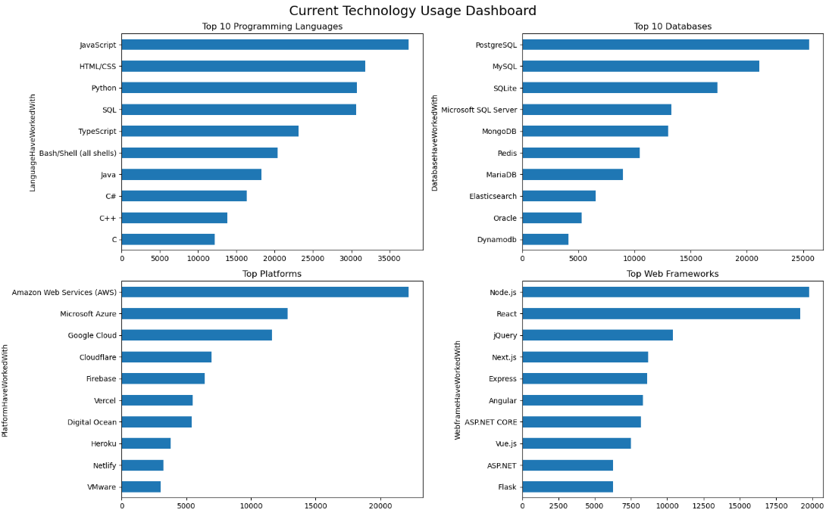
DASHBOARD TAB 1: Current Technology Usage
DASHBOARD INSIGHTS
JavaScript, Python, and SQL are the most widely used programming languages.
PostgreSQL and MySQL are the leading databases.
AWS, Azure, and Google Cloud dominate platform usage.
React and Node.js are among the most commonly used web frameworks.

Slide 18
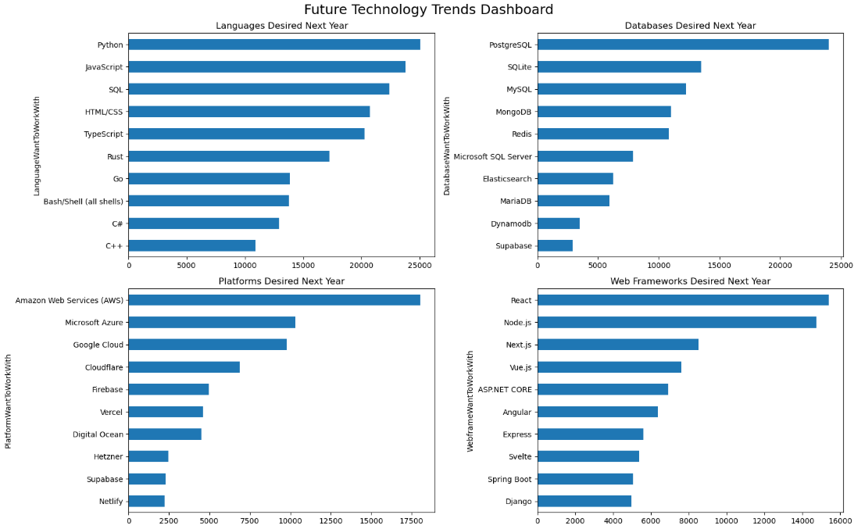
DASHBOARD TAB 2: Future Technology Trends
DASHBOARD INSIGHTS
Python remains one of the most desired programming languages.
PostgreSQL leads future database preferences.
Cloud platforms continue to attract strong developer interest.
Modern technologies such as Rust and TypeScript show increasing adoption potential.

Slide 19
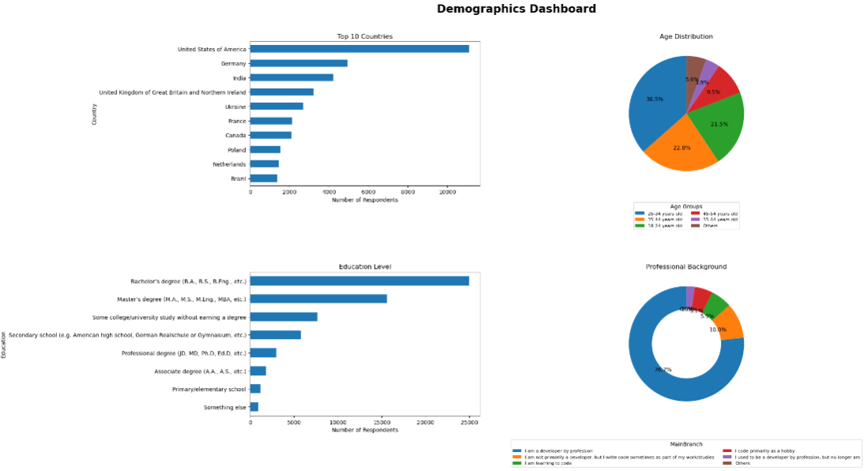
DASHBOARD TAB 3: Demographics
DASHBOARD INSIGHTS
Most respondents belong to the 25–44 age group.
United States, India, Germany, and the United Kingdom contribute the highest number of responses.
The majority of respondents hold a Bachelor's degree or higher.
Most respondents identify as professional developers.
SUMMARY OF DEMOGRAPHICS INSIGHTS
The survey primarily represents active software professionals.
Respondents come from a globally distributed developer community.
The demographic profile strengthens the reliability of the technology trend analysis.
Findings reflect the perspectives of experienced developers working in modern technology environments.

Slide 20
DISCUSSION
TECHNOLOGY USAGE TREND
Python, JavaScript, and SQL remain the most widely used programming languages, highlighting their importance across software development, data analytics, and cloud-based applications.
PostgreSQL and MySQL continue to dominate database usage, reflecting the ongoing relevance of relational database systems.
Cloud platforms such as AWS, Microsoft Azure, and Google Cloud have become essential components of modern technology environments.
FUTURE TECHNOLOGY TREND
Developers show strong interest in learning Python, PostgreSQL, TypeScript, and modern cloud technologies, indicating continued growth in these areas.
Emerging technologies are gaining attention as organizations increasingly adopt AI, automation, and scalable cloud-native solutions.
Future preferences suggest a shift toward technologies that support innovation, efficiency, and large-scale application development.
DEMOGRAPHIC TREND
The majority of respondents are between 25 and 44 years old, representing experienced and actively employed professionals.
Responses are concentrated in major technology markets including the United States, India, Germany, and the United Kingdom.
Most participants hold a Bachelor's degree or higher, indicating a highly skilled respondent base.
OVERALL CONCLUSION
The dashboard analysis reveals that Python, PostgreSQL, cloud platforms, and modern development frameworks are shaping the future technology landscape. Organizations that invest in these technologies and related workforce skills will be better positioned to meet future industry demands and maintain competitive advantage.

Slide 21
OVERALL FINDINGS & IMPLICATIONS
OVERALL FINDINGS
Finding 1: Technology Adoption
Python, JavaScript, SQL, PostgreSQL, and Cloud Platforms (AWS/Azure) remain the most widely adopted technologies.
These technologies form the foundation of modern software development, analytics, and cloud computing.
Finding 2: Future Technology Preferences
Developers show strong interest in Python, PostgreSQL, TypeScript, Rust, AI Tools, and Cloud Technologies.
Future demand is shifting toward AI-driven, scalable, and cloud-native solutions.
Finding 3: Workforce & Market Trends
Most respondents are experienced professionals aged 25–44 years.
Job opportunities are concentrated in major technology hubs such as Washington DC, Seattle, and New York.
High-demand skills continue to command competitive salaries.
IMPLICATIONS
Implication 1: Workforce Development
Organizations should prioritize training programs in Python, Cloud Computing, Data Engineering, and AI technologies.
Implication 2: Talent Acquisition Strategy
Recruitment efforts should focus on high-demand technical skills including Python, PostgreSQL, Cloud Platforms, and modern web technologies.
Implication 3: Business Competitiveness
Companies that invest early in emerging technologies and skill development will be better positioned to innovate and maintain competitive advantage.

Slide 22

CONCLUSION
The analysis successfully identified current and future technology trends using the Stack Overflow Developer Survey dataset.
Python, JavaScript, PostgreSQL, AWS, and Azure emerged as the most influential technologies across the developer ecosystem.
Future preferences indicate increasing adoption of AI, cloud computing, automation, and modern development technologies such as TypeScript and Rust.
Organizations should align hiring, training, and technology investments with these trends to ensure long-term growth and workforce readiness.
FINAL TAKEAWAY
"Python, Cloud Computing, PostgreSQL, and AI-related technologies are expected to remain key drivers of innovation and technology adoption in the coming years."

Slide 23

APPENDIX
Additional Analysis Performed
Exploratory Data Analysis
Age Distribution of Respondents
Country-wise Developer Distribution
Professional Background Analysis
Technology Analysis
Top Programming Languages
Top Databases
Platform Adoption Trends
Future Technology Preferences
Job Market Analysis
Geographic Distribution of Job Postings
Technology Salary Comparison
Supporting Materials
SQL Queries used for analysis
Data Wrangling and Transformation Steps
Dashboard Screenshots
Additional Charts and Visualizations

